Slide 1
Victory in Defeat
Main Verses: Isaiah 55:8-9 (NIV)
"For my thoughts are not your thoughts, neither are your ways my ways," declares the LORD. "As the heavens are higher than the earth, so are my ways higher than your ways and my thoughts than your thoughts.”

Slide 2
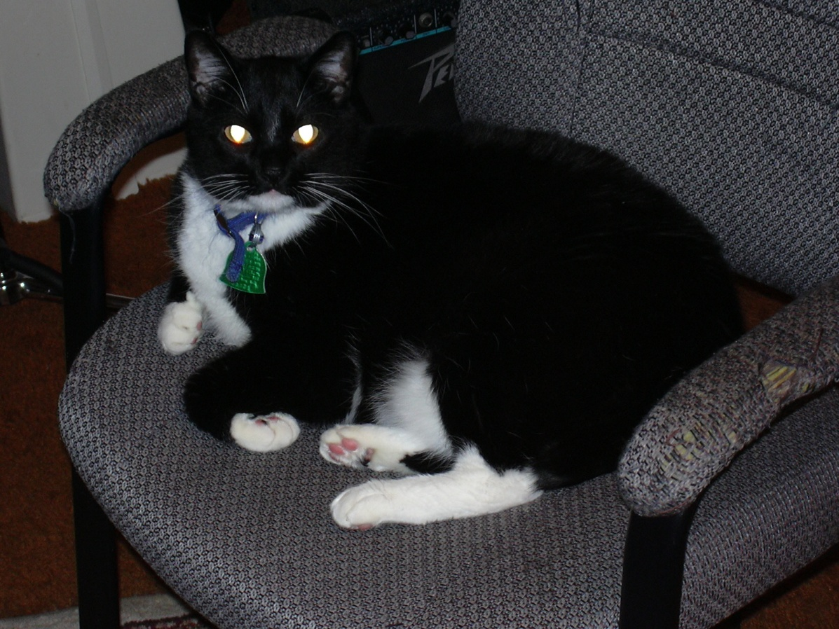
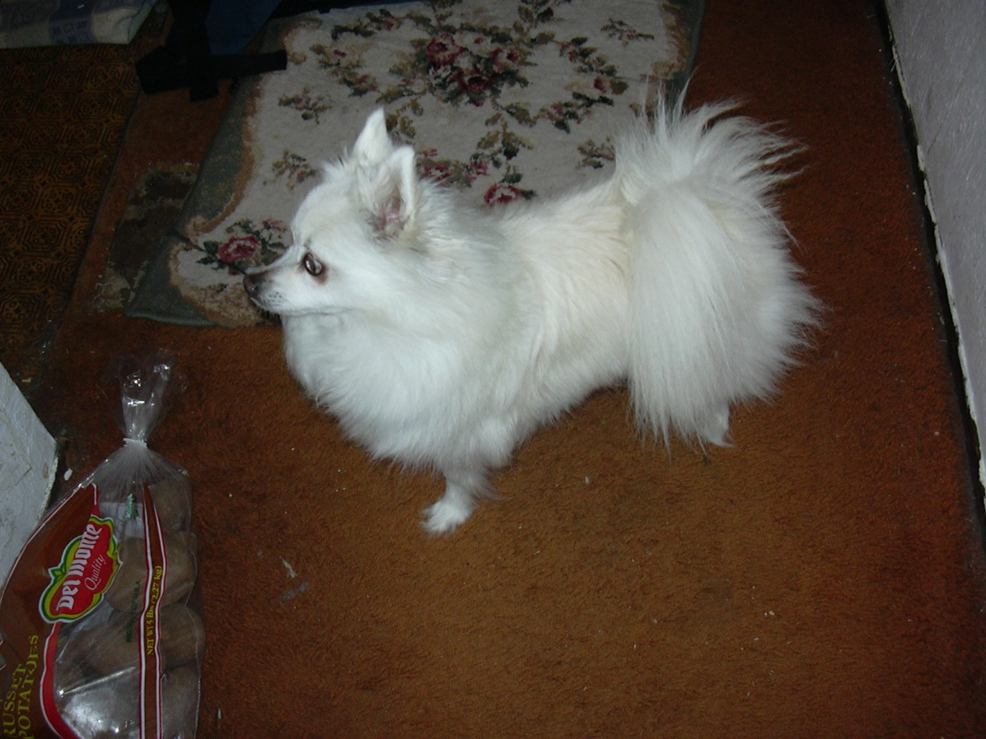

Slide 3
God’s ways vs. our own

Slide 4
God’s ways vs. our own
Priorities - Matthew 22:37-40 “'Love the Lord your God with all your heart and with all your soul and with all your mind.' This is the first and greatest commandment. And the second is like it: 'Love your neighbor as yourself.' All the Law and the Prophets hang on these two commandments”

Slide 5
God’s ways vs. our own
Priorities - Matthew 22:37-40 “'Love the Lord your God with all your heart and with all your soul and with all your mind.' This is the first and greatest commandment. And the second is like it: 'Love your neighbor as yourself.' All the Law and the Prophets hang on these two commandments”
Grace and Forgiveness –Luke 9:54-56 When the disciples James and John saw this, they asked, "Lord, do you want us to call fire down from heaven to destroy them?"

Slide 6
God’s ways vs. our own
Priorities - Matthew 22:37-40 “'Love the Lord your God with all your heart and with all your soul and with all your mind.' This is the first and greatest commandment. And the second is like it: 'Love your neighbor as yourself.' All the Law and the Prophets hang on these two commandments”
Grace and Forgiveness –Luke 9:54-56 When the disciples James and John saw this, they asked, "Lord, do you want us to call fire down from heaven to destroy them?" ^{“55} But Jesus turned and rebuked them, ⁵⁶ and they went to another village.”

Slide 7
God’s ways vs. our own
Priorities - Matthew 22:37-40 “'Love the Lord your God with all your heart and with all your soul and with all your mind.' This is the first and greatest commandment. And the second is like it: 'Love your neighbor as yourself.' All the Law and the Prophets hang on these two commandments”
Grace and Forgiveness –Luke 9:54-56 When the disciples James and John saw this, they asked, "Lord, do you want us to call fire down from heaven to destroy them?" ^{“55} But Jesus turned and rebuked them, ⁵⁶ and they went to another village.” Isaiah 55:6-7 “⁶ Seek the LORD while he may be found; call on him while he is near. ⁷ Let the wicked forsake his way and the evil man his thoughts. Let him turn to the LORD, and he will have mercy on him, and to our God, for he will freely pardon

Slide 8
God’s ways vs. our own
Priorities - Matthew 22:37-40 “'Love the Lord your God with all your heart and with all your soul and with all your mind.' This is the first and greatest commandment. And the second is like it: 'Love your neighbor as yourself.' All the Law and the Prophets hang on these two commandments”
Grace and Forgiveness –Luke 9:54-56 When the disciples James and John saw this, they asked, "Lord, do you want us to call fire down from heaven to destroy them?" ^{“55} But Jesus turned and rebuked them, ⁵⁶ and they went to another village.” Isaiah 55:6-7 “⁶ Seek the LORD while he may be found; call on him while he is near. ⁷ Let the wicked forsake his way and the evil man his thoughts. Let him turn to the LORD, and he will have mercy on him, and to our God, for he will freely pardon
Victory

Slide 9
Good from Bad, Victory in Defeat

Slide 10
Good from Bad, Victory in Defeat
Romans 8:28 “And we know that in all things God works for the good of those who love him, who have been called according to his purpose”.

Slide 11
Good from Bad, Victory in Defeat
Romans 8:28 “And we know that in all things God works for the good of those who love him, who have been called according to his purpose”.
Philippians 2:8, ”…being found in appearance as a man, he humbled himself and became obedient to death-- even death on a cross!” we find ourselves submitting to the trial laid before us.

Slide 12
Good from Bad, Victory in Defeat
2 Corinthians 12:9 “…My grace is sufficient for you, for my power is made perfect in weakness…

Slide 13
Good from Bad, Victory in Defeat
2 Corinthians 12:9 “…My grace is sufficient for you, for my power is made perfect in weakness…
2 Corinthians 12:10 That is why, for Christ's sake, I delight in weaknesses, in insults, in hardships, in persecutions, in difficulties. For when I am weak, then I am strong”.

Slide 14
Good from Bad, Victory in Defeat
2 Corinthians 12:9 “…My grace is sufficient for you, for my power is made perfect in weakness…
2 Corinthians 12:10 That is why, for Christ's sake, I delight in weaknesses, in insults, in hardships, in persecutions, in difficulties. For when I am weak, then I am strong”.
2 Corinthians 11:23 Are they servants of Christ? (I am out of my mind to talk like this.) I am more. I have worked much harder, been in prison more frequently, been flogged more severely, and been exposed to death again and again.

Slide 15
What it means to me?

Slide 16
What it means to me?
Philippians 3:14 (NIV) I press on toward the goal to win the prize for which God has called me heavenward in Christ Jesus.

Slide 17
What it means to me?
Philippians 3:14 (NIV) I press on toward the goal to win the prize for which God has called me heavenward in Christ Jesus.
Colossians 3:1-2 (NIV) ¹ Since, then, you have been raised with Christ, set your hearts on things above, where Christ is seated at the right hand of God. ² Set your minds on things above, not on earthly things.

Slide 18
Isaiah 55:8-9
"For my thoughts are not your thoughts, neither are your ways my ways," declares the LORD. "As the heavens are higher than the earth, so are my ways higher than your ways and my thoughts than your thoughts.”

Slide 19
Isaiah 55:8-9
"For my thoughts are not your thoughts, neither are your ways my ways," declares the LORD. "As the heavens are higher than the earth, so are my ways higher than your ways and my thoughts than your thoughts.”
1 Corinthians 1:23 but we preach Christ crucified: a stumbling block to Jews and foolishness to Gentiles.

