Slide 1
I Surrender All
Main Verses: Romans 10:3 (NIV)
Since they did not know the righteousness that comes from God and sought to establish their own, they did not submit to God's righteousness.

Slide 2
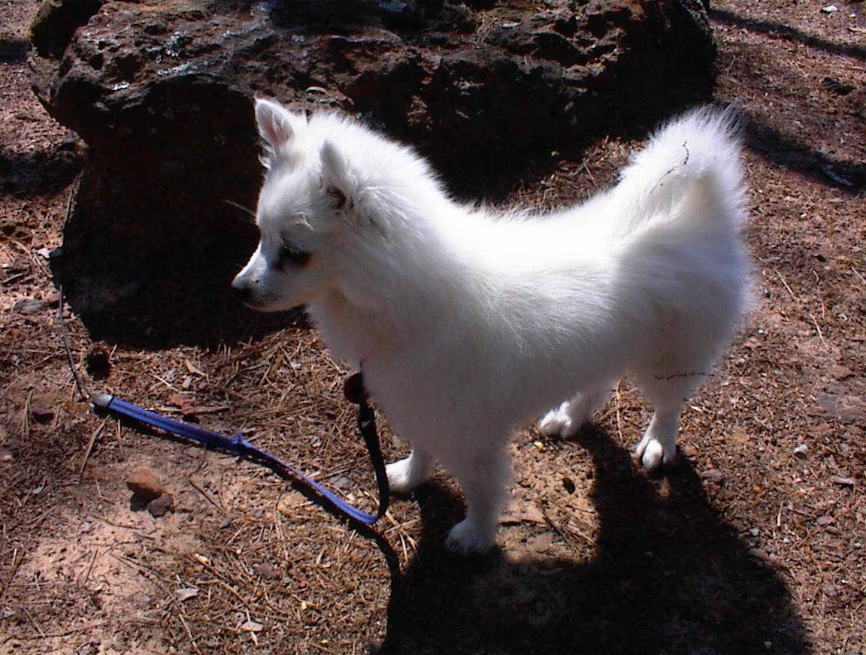
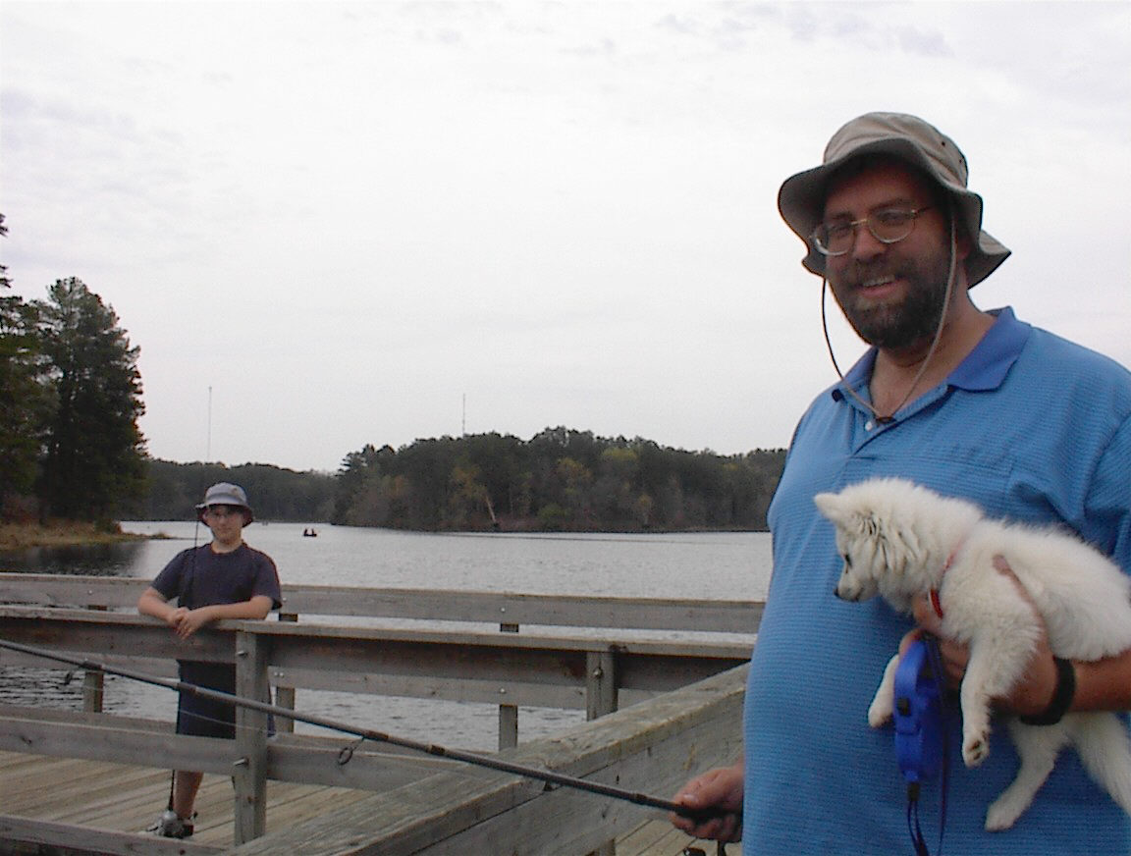
No, neither Chris or I caught a fish, but my daughter did…

Slide 3


Who’s in Control?

Slide 4
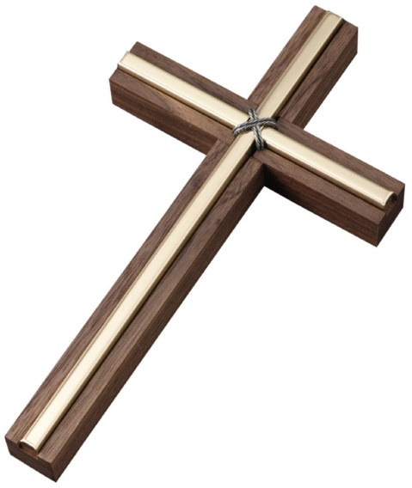
Who’s in Control?
Isaiah 40:25 (NIV)
"To whom will you compare me? Or who is my equal?" says the Holy One.

Slide 5
Who’s in Control?
Isaiah 40:25 (NIV)
"To whom will you compare me? Or who is my equal?" says the Holy One.
Isaiah 14:14 (NIV)
I will ascend above the tops of the clouds; I will make myself like the Most High."

Slide 6

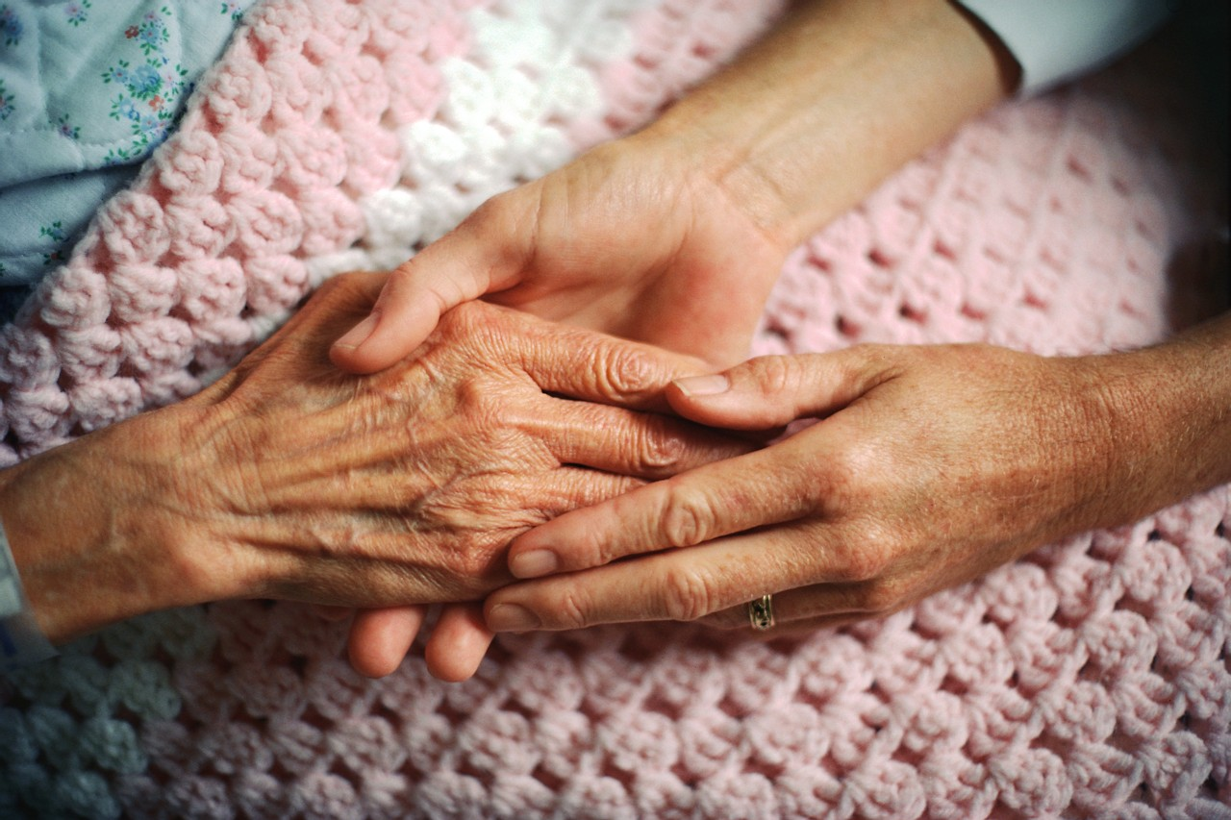
Trust

Slide 7
Trust
Ephesians 5:22 (NIV)
Wives, submit to your husbands as to the Lord.

Slide 8
Trust
Ephesians 5:20-21 (NIV)
…always giving thanks to God the Father for everything, in the name of our Lord Jesus Christ.
Submit to one another out of reverence for Christ.
Ephesians 5:22 (NIV)
Wives, submit to your husbands as to the Lord.

Slide 9
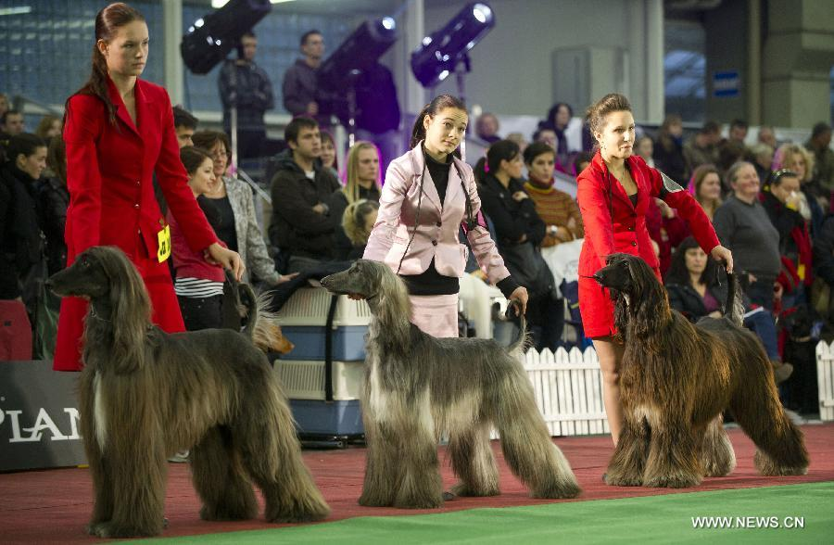
Discipline

Slide 10
Discipline
Proverbs 3:11-12 (NIV)
My son, do not despise the LORD's discipline and do not resent his rebuke,
because the LORD disciplines those he loves, as a father the son he delights in.

Slide 11
Discipline
Proverbs 3:11-12 (NIV)
My son, do not despise the LORD's discipline and do not resent his rebuke,
because the LORD disciplines those he loves, as a father the son he delights in.
Hebrews 12:7-11 (NIV)
⁷ Endure hardship as discipline; God is treating you as sons. For what son is not disciplined by his father? ⁸ If you are not disciplined (and everyone undergoes discipline), then you are illegitimate children and not true sons. ⁹ Moreover, we have all had human fathers who disciplined us and we respected them for it. How much more should we submit to the Father of our spirits and live! ¹⁰ Our fathers disciplined us for a little while as they thought best; but God disciplines us for our good, that we may share in his holiness. ¹¹ No discipline seems pleasant at the time, but painful. Later on, however, it produces a harvest of righteousness and peace for those who have been trained by it.

Slide 12
Discipline

Slide 13
Discipline
Revelation 3:19-20 (NIV)
¹⁹ Those whom I love I rebuke and discipline. So be earnest, and repent.
²⁰ Here I am! I stand at the door and knock. If anyone hears my voice and opens the door, I will come in and eat with him, and he with me.

Slide 14
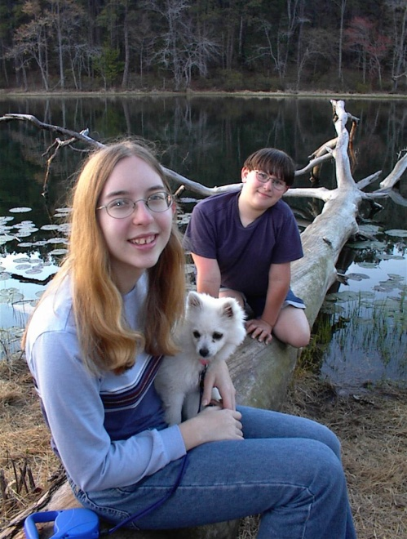
Discipline
Revelation 3:19-20 (NIV)
¹⁹ Those whom I love I rebuke and discipline. So be earnest, and repent.
²⁰ Here I am! I stand at the door and knock. If anyone hears my voice and opens the door, I will come in and eat with him, and he with me.
Proverbs 22:6 (NIV)
Train a child in the way he should go, and when he is old he will not turn from it.

Slide 15
Discipline
Revelation 3:19-20 (NIV)
¹⁹ Those whom I love I rebuke and discipline. So be earnest, and repent.
²⁰ Here I am! I stand at the door and knock. If anyone hears my voice and opens the door, I will come in and eat with him, and he with me.
Proverbs 22:6 (NIV)
Train a child in the way he should go, and when he is old he will not turn from it.
Revelation 3:5 (NIV)
He who overcomes will, like them, be dressed in white. I will never blot out his name from the book of life, but will acknowledge his name before my Father and his angels.

Slide 16
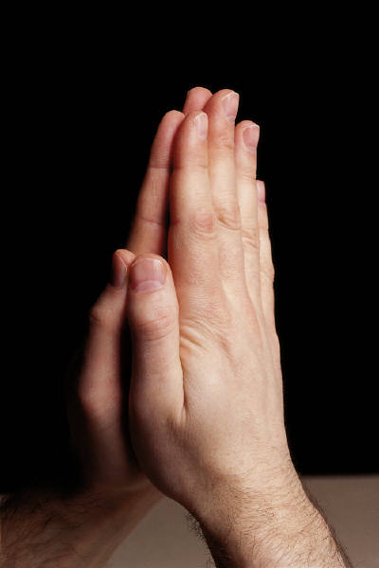
Putting it together

Slide 17
Putting it together
John 16:33 (NIV)
³³ "I have told you these things, so that in me you may have peace. In this world you will have trouble. But take heart! I have overcome the world."

Slide 18
Putting it together
John 16:33 (NIV)
³³ "I have told you these things, so that in me you may have peace. In this world you will have trouble. But take heart! I have overcome the world."
Ephesians 2:8 (NIV)
⁸ For it is by grace you have been saved, through faith--and this not from yourselves, it is the gift of God--

Slide 19
Putting it together
Romans 8:28 (NIV)
²⁸ And we know that in all things God works for the good of those who love him, who have been called according to his purpose.

Slide 20
Putting it together
Romans 8:28 (NIV)
²⁸ And we know that in all things God works for the good of those who love him, who have been called according to his purpose.
To gain this victory I surrender all, what about you?

