Slide 1
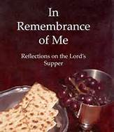
Notes:
Title slide as I come to pulpit

Slide 2
1 Corinthians 11:23-30
Notes:
Slide announcing Scripture text

Slide 3
1 Corinthians 11:23-29
23 For I have received of the Lord that which also I delivered unto you, that the Lord Jesus, the same night in which he was betrayed, took bread;
24 And when he had given thanks, he broke it, and said, Take, eat; this is my body, which is broken for you: this do in remembrance of me.

Slide 4
25 After the same manner also he took the cup, when he had supped, saying, This cup is the new testament in my blood: this do, as often as you drink it, in remembrance of me.
26For as often as you eat this bread, and drink this cup, ye do show the Lord’s death till he come.
27Wherefore, whosoever shall eat this

Slide 5
bread , and drink this cup of the Lord, unworthily, shall be guilty of the body and blood of the Lord.
28But let a man examine himself, and so let him eat of that bread, and drink of that cup.
29 For he that eats and drinks unworthily, eats and drinks judgment to himself,
Notes:
FOLLOW THIS READING CLOSELY

Slide 6
not discerning the Lord’s body.
30 For this cause many are weak and sickly among you, and many sleep.

Slide 7
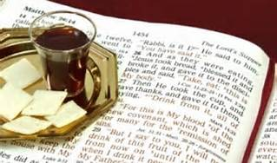
Notes:
The Lord’s supper is not a “sacrament” that conveys salvation. It is a MEMORIAL SERVICE.
We participate to REMEMBER JESUS. He gave us the bread and wine so we will focus rightly.

Slide 8
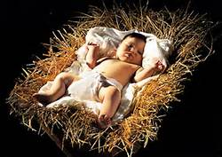
Remember HIS BIRTH
MIRACULOUS-No earthly father.
GOD INCARNATE-Fully human,
-Fully divine
Notes:
The VIRGIN BIRTH is important for our salvation.

Slide 9
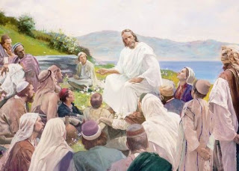
His SINLESS LIFE
Taught the truth about God
Personified God’s Character
Proved his deity by miracles
“Never did a man speak like this man”
--John 7:46

Slide 10
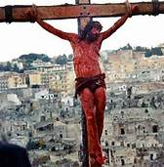
SUBSTITUTIONARY DEATH
This is my body, which is broken for you
Notes:
The essence of the Lord’s Supper: He took the penalty of our sins upon himself.

Slide 11
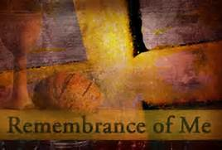
Notes:
Is Christ in your heart today? If not, do not eat the Lord’s Supper. Will you accept Him RIGHT NOW?

