Slide 1
JOHN 14:1-3
1. “Let not your heart be troubled; you believe in God, believe also in Me.
2. In My Father’s house are many mansions; if it were not so, I would have told you. I go to prepare a place for you.
3. And if I go and prepare a place for you, I will come again and receive you to Myself; that where I am, there you may be also.”
Notes:
Many modern translations have ROOMS instead of Mansions. Literal=staying places.
Jesus is reassuring His disciples that, though He will be betrayed and killed, He will be in Heaven with God the Father preparing a place there for when He comes to get them. LOTS OF ROOM. What kind of place? It’s going to be good if Jesus builds it.

Slide 2
Jesus grew up building things
Notes:
On earth, He became a master carpenter. Not only with wood. The Greek word means someone who also works with stone. There was not a lot of wood in Israel, but plenty of stones—rocks everywhere!

Slide 3
Most houses were built of stones
Notes:
The typical house had rooms, some second-story, (remember the “UPPER ROOM), built around an open courtyard like this picture.
In doing some research, I discovered that married sons would ADD ON ROOMS to their father’s house when they married; so Jesus’ hearers would relate to “MANY ROOMS”.

Slide 4
Many rooms could be built on
Notes:
Archaeologists have found ancient homes with MANY ROOMS ADDED.

Slide 5
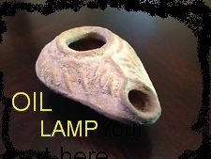
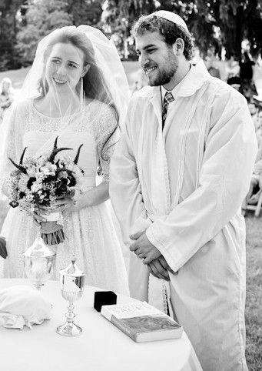
marriage customs
Then shall the kingdom of heaven be likened to ten virgins who took their lamps and
went out to meet the
bridegroom…the foolish
took no oil with them. But while
the bridegroom was delayed, they all
slept. And at midnight a cry was
heard: Behold, the bridegroom is
coming; go out to meet him!
Matthew 25:1-6
Notes:
Marriages, in Jesus’ day, were arranged by the fathers. The Bride Price was negotiated and paid. They were espoused. The bridegroom promised to return for her when the house was prepared. She waited. The wedding occurred when the bridegroom returned. Wedding guests, dressed in special garments, waited. If at night they had to have a lamp for the procession or could not participate in the festivities.

Slide 6
Ancient oil lamp
Notes:
This is an ancient oil lamp I bought in Israel and had it mounted on pedestal. It was made with a rare black clay. Note the size. It could not contain much olive oil.

Slide 7
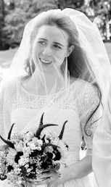
The church is the bride of christ
Ephesians 5:25 - 32
Notes:
The Father has given the Church to Jesus to be his bride.

Slide 8
Eph. 5
Husbands, love your wives as Christ also loved the church and gave Himself for her.
that He might sanctify and cleanse her with the washing of water by the word.
that He might present her to Himself a glorious church, not having spot or wrinkle or any such thing, but that she should be holy and without blemish…

Slide 9
Eph. 5
31 “For this reason a man shall leave his father and mother and be joined to his wife, and the two shall become one flesh.” (Paul quotes Genesis 2:24)
32 This is a great mystery, but I speak concerning Christ and the church.
Notes:
The bride price was negotiated by the fathers of the bride and groom, and reflected her value to him. WHAT WAS THE FATHER WILLING TO PAY? His death on the Cross.

Slide 10
The price Christ paid
For His Bride
“He gave himself for her…”
Notes:
“Christ also loved the church and GAVE HIMSELF FOR HER…” Eph. 5:25

Slide 11
“I go to prepare a
place for you…
You go into all the world and be my witnesses.”
Notes:
We have work to do to prepare for His coming to get His bride. His bride must be ready the moment He comes. The Holy Spirit (symbolized by the oil in the lamps) empowers us to learn, to grow, to make disciples and teach them to observe all He has commanded (Matthew 28:19,20)

Slide 12
Are you ready?
Notes:
He WILL come to take His bride to her home with the Father. We must be ready, with our lamps burning bright!

