Slide 2
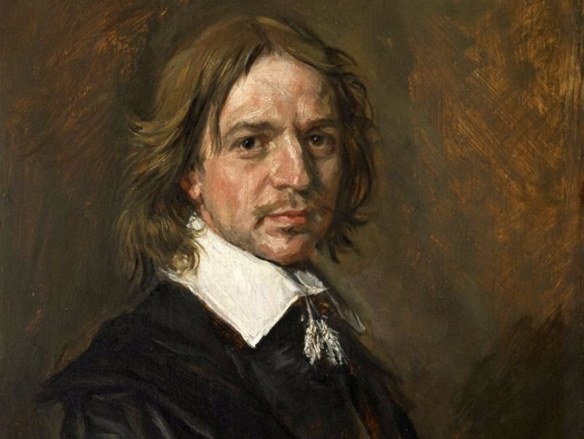

Slide 3
lakewayonline.org
lakeway.xyz

Slide 4
Matthew 6:1-4 (NIV)
“Be careful not to practice your righteousness in front of others to be seen by them. If you do, you will have no reward from your Father in heaven.

Slide 5
² “So when you give to the needy, do not announce it with trumpets, as the hypocrites do in the synagogues and on the streets, to be honored by others. Truly I tell you, they have received their reward in full.

Slide 6
³ But when you give to the needy, do not let your left hand know what your right hand is doing,⁴ so that your giving may be in secret. Then your Father, who sees what is done in secret, will reward you.

Slide 7
Matthew 6:1-4 (NIV)
“Be careful not to practice your righteousness in front of others to be seen by them. If you do, you will have no reward from your Father in heaven.

Slide 8
Matthew 6:1-4 (NIV)
“Be careful not to practice your righteousness in front of others to be seen by them. If you do, you will have no reward from your Father in heaven.

Slide 9
Righteousness
dikaiosune (dik-ah-yos-oo-nay):
someone who is as they ought to be, the condition acceptable to God

Slide 10
² “So when you give to the needy, do not announce it with trumpets, as the hypocrites do in the synagogues and on the streets, to be honored by others. Truly I tell you, they have received their reward in full.

Slide 11
³ But when you give to the needy, do not let your left hand know what your right hand is doing,⁴ so that your giving may be in secret. Then your Father, who sees what is done in secret, will reward you.

Slide 12
Righteousness
dikaiosune (dik-ah-yos-oo-nay):
someone who is as they ought to be, the condition acceptable to God

Slide 13
In Christ
You are the real deal
Live like the real deal

